Slide 1
Murach’s ASP.NET Core MVC (2nd Ed.)
Chapter 14
How to use dependency injection and unit testing

Slide 2
Objectives (part 1)
Applied
Use dependency injection (DI) to make the code for an ASP.NET Core web app more flexible and easier to change.
Use unit testing to automate the testing of a web app.
Knowledge
Describe how to configure a web app for dependency injection.
List and describe the three dependency life cycles.
Distinguish between controllers that are tightly coupled with EF Core and controllers that are loosely coupled with EF Core.
Explain how dependency chaining works with repository objects.
Describe the use of DI with an HttpContextAccessor object.
Describe the use of DI with an action method that uses the FromServices attribute.

Slide 3
Objectives (part 2)
Describe the use of DI to inject an object into a view.
Explain how unit testing works.
Describe three advantages of unit testing.
Explain how to add an xUnit project to a solution.
Describe the Arrange/Act/Assert (AAA) pattern that’s often used to organize the code for a unit test.
Explain how to run unit tests.
Describe the use of a fake object to test methods that have dependencies.
Describe the use of Moq to create fake objects.

Slide 4
Three methods of the IServiceCollection object that map dependencies
AddTransient<interface, class>()
AddScoped<interface, class>()
AddSingleton<interface, class>()

Slide 5
How to configure DI for a class that doesn’t use generics
var builder = WebApplication.CreateBuilder(args);
...
builder.Services.AddTransient<IBookRepository,
BookRepository>();
...
How to configure DI for a generic class
builder.Services.AddTransient(typeof(IRepository<>),
typeof(Repository<>));

Slide 6
How to configure DI for the HTTP context accessor
Manually
builder.Services.AddSingleton<IHttpContextAccessor,
HttpContextAccessor>();
With a method of the IServiceCollection object
builder.Services.AddHttpContextAccessor();

Slide 7
An Author controller
That injects a DbContext object
public class AuthorController : Controller
{
private Repository<Author> data { get; set; }
public AuthorController(BookstoreContext ctx) =>
data = new Repository<Author>(ctx);
...
}
That injects a repository object
public class AuthorController : Controller
{
private IRepository<Author> data { get; set; }
public AuthorController(IRepository<Author> rep) =>
data = rep;
...
}

Slide 8
How to use Visual Studio to generate an interface for a class
Open the C# file that contains the class and right-click the class name.
In the context menu, select the Quick Actions and Refactoring item, then select the Extract Interface item.
In the Extract Interface dialog, enter a name, a destination, select the public members of the interface, and click OK.
Visual Studio will generate the interface and update the class to implement the interface.

Slide 9
The ICart interface generated by Visual Studio from the Cart class
public interface ICart
{
int? Count { get; }
IEnumerable<CartItem> List { get; }
double Subtotal { get; }
void Add(CartItem item);
void Clear();
void Edit(CartItem item);
CartItem? GetById(int? id);
void Load(IRepository<Book> data);
void Remove(CartItem item);
void Save();
}

Slide 10
The Cart class updated by Visual Studio to implement the ICart interface
public class Cart : ICart {
...
}
The DI mapping in the Program.cs file
// other DI mappings
builder.Services.AddTransient<ICart, Cart>();

Slide 11
A Cart class that injects an HttpContextAccessor object
public class Cart : ICart
{
...
private ISession session { get; set; }
private IRequestCookieCollection requestCookies { get; set; }
private IResponseCookies responseCookies { get; set; }
public Cart(IHttpContextAccessor ctx) {
session = ctx.HttpContext!.Session;
requestCookies = ctx.HttpContext!.Request.Cookies;
responseCookies = ctx.HttpContext!.Response.Cookies;
}
public void Load(IRepository<Book> data) {
// code that uses the repository and HttpContext
// to load cart items
}
...
}

Slide 12
A Cart controller that injects a Cart object
public class CartController : Controller
{
private IRepository<Book> data { get; set; }
private Cart cart { get; set; } // model-level Cart object
public CartController(IRepository<Book> rep, ICart c) {
data = rep;
cart = c; // create model-level Cart object
cart.Load(data); // load cart items
}
public ViewResult Index() {
// use model-level Cart object – method no longer needs
// to create its own Cart object
var vm = new CartViewModel {
List = cart.List,
Subtotal = cart.Subtotal
};
return View(vm);
}
// rest of Cart methods that use the model-level Cart object
}

Slide 13
A controller whose constructor accepts a DbContext object
public class ValidationController : Controller
{
// private repository properties
private Repository<Author> authorData { get; set; }
private Repository<Genre> genreData { get; set; }
// constructor that accepts a DB context and initalizes repositories
public ValidationController(BookstoreContext ctx) {
authorData = new Repository<Author>(ctx);
genreData = new Repository<Genre>(ctx);
}
public JsonResult CheckGenre(string genreId) {
validate.CheckGenre(genreId, genreData);
...
}
public JsonResult CheckAuthor(string firstName, string lastname,
string operation) {
validate.CheckAuthor(firstName, lastName, operation, authorData);
...
}
}

Slide 14
The same controller with DI in its action methods
public class ValidationController : Controller
{
// private properties and constructor no longer needed
public JsonResult CheckGenre(
string genreId, [FromServices] IRepository<Genre> data) {
validate.CheckGenre(genreId, data);
...
}
public JsonResult CheckAuthor(string firstName, string lastName,
string operation, [FromServices] IRepository<Author> data) {
validate.CheckAuthor(firstName, lastName, operation, data);
...
}
}

Slide 15
A navigation link in a layout view that uses the Cart object
<a class="nav-link" asp-action="Index"
asp-controller="Cart" asp-area="">
<span class="fas fa-shopping-cart"></span>&nbsp;Cart
<span class="badge badge-light">@cart.Count</span>
</a>

Slide 16
Code in a layout that creates a Cart object
@{
var cart = new Cart(Context);
...
}
Code in a layout that injects a Cart object
@inject ICart cart
@{
...
}

Slide 17
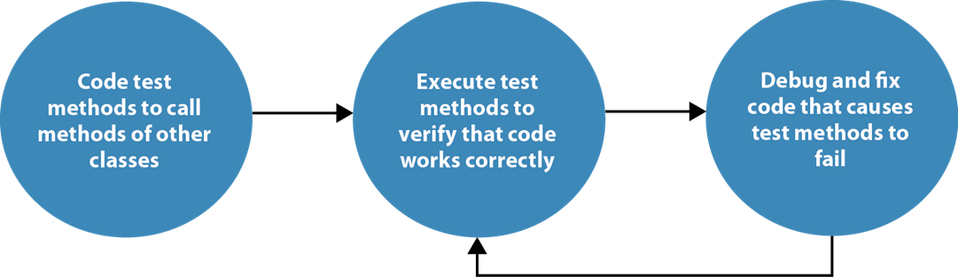
The unit testing process

Slide 18
Advantages of unit testing
It reduces the amount of time you have to spend manually testing an app by running it and entering data.
It makes it easy to test an app after each significant code change. This helps you find problems earlier in the development cycle than you typically would when using manual testing.
It makes debugging easier because you typically test an app after each significant code change. As a result, when a test fails, you only need to debug the most recent code changes.

Slide 19
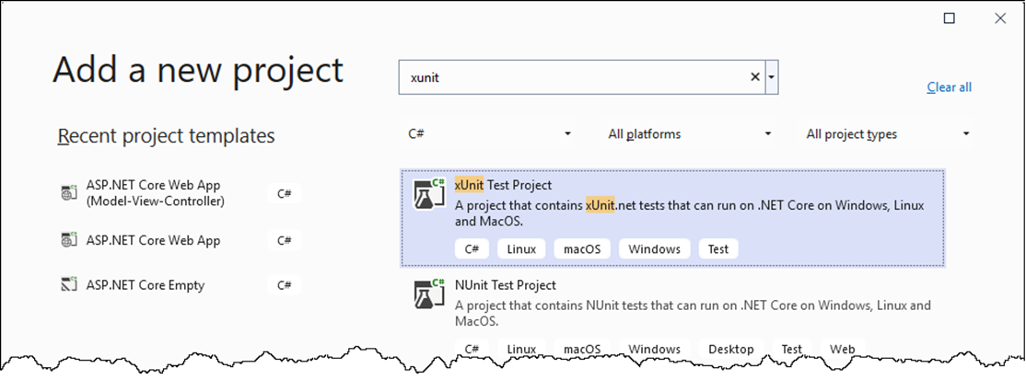
The Add a new project dialog
How to add a unit test project to a solution
Right-click the solution and select Add→New Project.
In the Add a new project dialog, select the xUnit Test Project template and click Next. To help find the template, you can search for “xunit”.
Enter a name and location for the project and click Create.

Slide 20
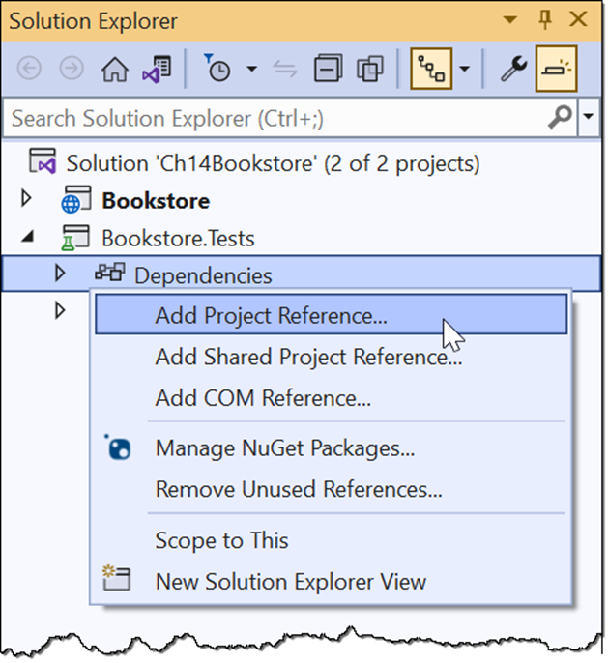
The web app project and the unit test project

Slide 21
Some static methods of the Assert class
Equal(expected, result)
NotEqual(expected, result)
False(Boolean)
True(Boolean)
IsType<T>(result)
IsNull(result)

Slide 22
Three attributes of the Xunit namespace
Fact
Theory
InlineData(p1, p2, ...)

Slide 23
A test class with two test methods (part 1)
public class NavTests
{
[Fact]
public void ActiveMethod_ReturnsAString()
{
string s1 = "Home"; // arrange
string s2 = "Books";
var result = Nav.Active(s1, s2); // act
Assert.IsType<string>(result); // assert
}

Slide 24
A test class with two test methods (part 2)
[Theory]
[InlineData("Home", "Home")]
[InlineData("Books", "Books")]
public void ActiveMethod_ReturnsValueActiveIfMatch(
string s1, string s2)
{
string expected = "active"; // arrange
var result = Nav.Active(s1, s2); // act
Assert.Equal(expected, result); // assert
}
}

Slide 25
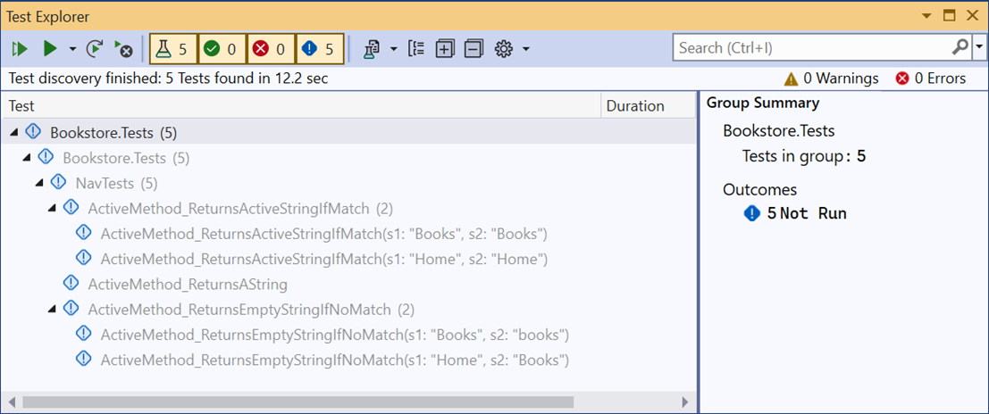
The Test Explorer in Visual Studio
Two ways to open the Test Explorer
From the menu system, select Test→Test Explorer.
In the Solution Explorer, right-click on the test class and select Run Tests.

Slide 26
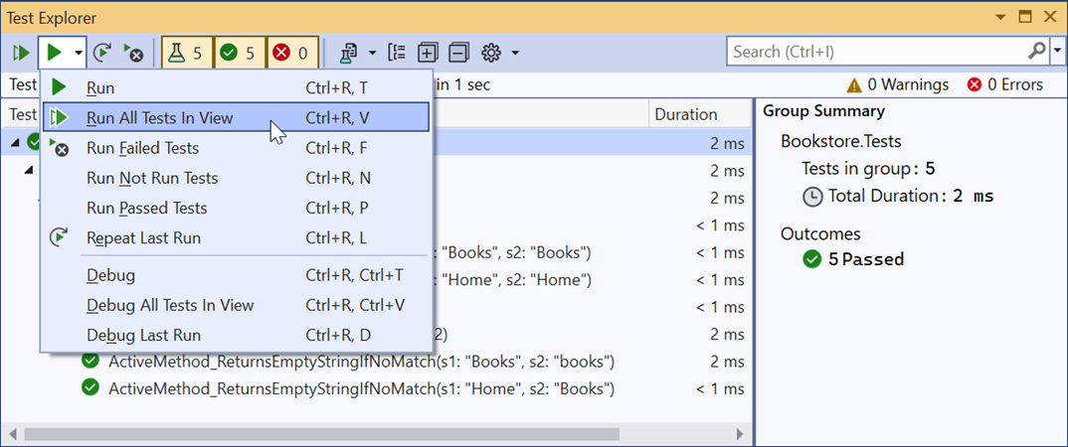
Some options to run tests in Test Explorer

Slide 27
A controller that depends on a repository object
public class HomeController : Controller
{
private IRepository<Book> data { get; set; }
public HomeController(IRepository<Book> rep) => data = rep;
public ViewResult Index() {
var random = data.Get(new QueryOptions<Book> {
OrderBy = b => Guid.NewGuid()
});
return View(random);
}
}

Slide 28
A fake repository class that implements the Get() method
using Bookstore.Models;
...
public class FakeBookRepository : IRepository<Book>
{
public int Count =>
throw new NotImplementedException();
public void Delete(Book entity) =>
throw new NotImplementedException();
public Book Get(QueryOptions<Book> options) =>
new Book();
...
}

Slide 29
A unit test that passes an instance of the fake repository to the controller
[Fact]
public void IndexActionMethod_ReturnsAViewResult() {
// arrange
var rep = new FakeBookRepository();
var controller = new HomeController(rep);
// act
var result = controller.Index();
// assert
Assert.IsType<ViewResult>(result);
}

Slide 30
How to use Visual Studio to implement an interface
Create a new class that implements the interface. Visual Studio will display a red squiggle that indicates that the interface hasn’t been implemented.
Hover the mouse pointer over the red squiggle, click the lightbulb icon, and select Implement Interface to generate stubs for each property and method of the interface.

Slide 31
An action method that accesses TempData
[HttpPost]
public IActionResult Edit(Author author)
{
if (ModelState.IsValid) {
data.Update(author);
data.Save();
TempData["message"] = $"{author.FullName} updated.";
return RedirectToAction("Index");
}
else {
return View("Author", author);
}
}

Slide 32
The FakeTempData class with an indexer that does nothing
using Microsoft.AspNetCore.Mvc.ViewFeatures;
...
public class FakeTempData : ITempDataDictionary
{
public object? this[string key] { get => null; set { } }
public ICollection<string> Keys =>
throw new NotImplementedException();
...
}
Two methods of the FakeAuthorRepository class that do nothing
public void Update(Author entity) { }
public void Save() { }

Slide 33
A test method that tests the action method that uses TempData
[Fact]
public void Edit_POST_ReturnsRedirectToActionResultIfModelStateIsValid() {
// arrange
var rep = new FakeAuthorRepository();
var controller = new AuthorController(rep) {
TempData = new FakeTempData()
};
// act
var result = controller.Edit(new Author());
// assert
Assert.IsType<RedirectToActionResult>(result);
}

Slide 34
How to add Moq to your test project
In the Solution Explorer, right-click the test project and select Manage NuGet Packages from the resulting menu.
In the NuGet Package Manager, click Browse, search for “moq”, select the Moq package, and click Install.
In the resulting dialogs, click OK and I Accept.

Slide 35
Two methods of the Mock<T> class
Setup(lambda)
Returns(value)
One property of the Mock<T> class
Object
Two static methods of the It class
IsAny<T>()
Is<T>(lambda)

Slide 36
The using directive for the Moq namespace
using Moq;
Code that creates a Mock<IRepository<Author>> object
var rep = new Mock<IRepository<Author>>();
Code that sets up Get() to accept any int and return an Author object
rep.Setup(m => m.Get(It.IsAny<int>())).Returns(new Author());
The same code statement adjusted to accept any int greater than zero
rep.Setup(m => m.Get(It.Is<int>(i => i > 0))).Returns(new Author());
Code that passes the mock object to a controller
var controller = new AuthorController(rep.Object);

Slide 37
A test method that mocks a repository object
using Bookstore.Controllers;
...
[Fact]
public void IndexActionMethod_ReturnsViewResult()
{
// arrange
var rep = new Mock<IRepository<Book>>();
rep.Setup(m => m.Get(It.IsAny<QueryOptions<Book>>()))
.Returns(new Book());
var controller = new HomeController(rep.Object);
// act
var result = controller.Index();
// assert
Assert.IsType<ViewResult>(result);
}

Slide 38
A test method that mocks a TempData object
using Bookstore.Areas.Admin.Controllers;
using Microsoft.AspNetCore.Mvc.ViewFeatures;
...
[Fact]
public void Edit_POST_ReturnsRedirectToActionResultIfModelStateIsValid()
{
// arrange
var rep = new Mock<IRepository<Author>>();
var temp = new Mock<ITempDataDictionary>();
var controller = new AuthorController(rep.Object)
{
TempData = temp.Object
};
// act
var result = controller.Edit(new Author());
// assert
Assert.IsType<RedirectToActionResult>(result);
}

Slide 39
The constructor of the Cart class
public Cart(IHttpContextAccessor ctx)
{
// assign private variables
session = ctx.HttpContext!.Session;
requestCookies = ctx.HttpContext!.Request.Cookies;
responseCookies = ctx.HttpContext!.Response.Cookies;
items = new List<CartItem>();
}
The Subtotal property of the Cart class
public double Subtotal => items.Sum(i => i.Subtotal);

Slide 40
A test method that tests the Subtotal property of the Cart with Moq (part 1)
using Microsoft.AspNetCore.Http;
...
[Fact]
public void SubtotalProperty_ReturnsADouble()
{
// arrange
var accessor = new Mock<IHttpContextAccessor>();
var context = new DefaultHttpContext();
accessor.Setup(m => m.HttpContext).Returns(context);
accessor.Setup(m =>
m.HttpContext!.Request).Returns(context.Request);
accessor.Setup(m =>
m.HttpContext!.Response).Returns(context.Response);
accessor.Setup(m => m.HttpContext!.Request.Cookies)
.Returns(context.Request.Cookies);
accessor.Setup(m => m.HttpContext!.Response.Cookies)
.Returns(context.Response.Cookies);

Slide 41
A test method that tests the Subtotal property of the Cart with Moq (part 2)
var session = new Mock<ISession>();
accessor.Setup(m =>
m.HttpContext!.Session).Returns(session.Object);
Cart cart = new Cart(accessor.Object);
cart.Add(new CartItem { Book = new BookDTO() });
// act
var result = cart.Subtotal;
// assert
Assert.IsType<double>(result);
}

Slide 42
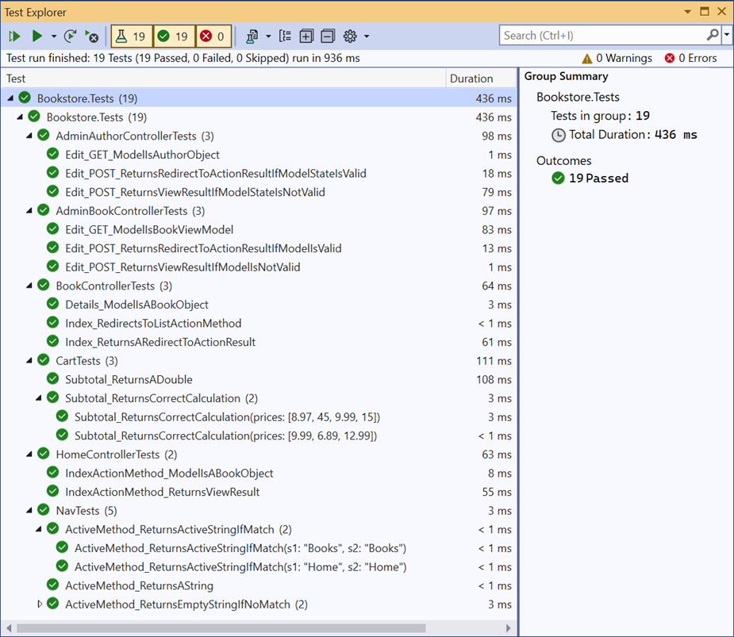
The Test Explorer for the Bookstore.Tests project

Slide 43
The Usings.cs file
global using Xunit;
global using Microsoft.AspNetCore.Mvc;
global using Bookstore.Models;
global using Moq;

Slide 44
The BookControllerTests class (part 1)
using Bookstore.Controllers;
namespace Bookstore.Tests
{
public class BookControllerTests
{
[Fact]
public void Index_ReturnsARedirectToActionResult() {
// arrange
var rep = new Mock<IRepository<Book>>();
var controller = new BookController(rep.Object);
// act
var result = controller.Index();
// assert
Assert.IsType<RedirectToActionResult>(result);
}

Slide 45
The BookControllerTests class (part 2)
[Fact]
public void Index_RedirectsToListActionMethod() {
// arrange
var rep = new Mock<IRepository<Book>>();
var controller = new BookController(rep.Object);
// act
var result = controller.Index();
// assert
Assert.Equal("List", result.ActionName);
}

Slide 46
The BookControllerTests class (part 3)
[Fact]
public void Details_ModelIsABookObject() {
// arrange
var rep = new Mock<IRepository<Book>>();
rep.Setup(m => m.Get(It.IsAny<QueryOptions<Book>>()))
.Returns(new Book());
var controller = new BookController(rep.Object);
// act
var model = controller.Details(1).ViewData.Model;
// assert
Assert.IsType<Book>(model);
}
}
}

Slide 47
The AdminBookControllerTests class (part 1)
using Microsoft.AspNetCore.Mvc.ViewFeatures;
using Bookstore.Areas.Admin.Controllers;
namespace Bookstore.Tests
{
public class AdminBookControllerTests
{
// helper method for unit test class – not a test
public BookController GetBookController()
{
// mock book repository
var bookRep = new Mock<IBookRepository>();
bookRep.Setup(m => m.Get(It.IsAny<QueryOptions<Book>>()))
.Returns(new Book());
bookRep.Setup(m => m.List(It.IsAny<QueryOptions<Book>>()))
.Returns(new List<Book>());
// mock author repository
var authorRep = new Mock<IRepository<Author>>();
authorRep.Setup(m => m.List(It.IsAny<QueryOptions<Author>>()))
.Returns(new List<Author>());

Slide 48
The AdminBookControllerTests class (part 2)
// mock genre repository
var genreRep = new Mock<IRepository<Genre>>();
genreRep.Setup(m => m.List(It.IsAny<QueryOptions<Genre>>()))
.Returns(new List<Genre>());
// return controller
return new BookController(
bookRep.Object, authorRep.Object,
genreRep.Object);
}
[Fact]
public void Edit_GET_ModelIsBookObject()
{
// arrange
var controller = GetBookController();
// act
var model = controller.Edit(1).ViewData.Model;
// assert
Assert.IsType<BookViewModel>(model);
}

Slide 49
The AdminBookControllerTests class (part 3)
[Fact]
public void Edit_POST_ReturnsViewResultIfModelIsNotValid()
{
// arrange
var controller = GetBookController();
controller.ModelState.AddModelError("", "Test error message.");
BookViewModel vm = new BookViewModel();
// act
var result = controller.Edit(vm);
// assert
Assert.IsType<ViewResult>(result);
}

Slide 50
The AdminBookControllerTests class (part 4)
[Fact]
public void Edit_POST_ReturnsRedirectToActionResultIfModelIsValid()
{
// arrange
var controller = GetBookController();
var temp = new Mock<ITempDataDictionary>();
controller.TempData = temp.Object;
BookViewModel vm = new BookViewModel { Book = new Book() };
// act
var result = controller.Edit(vm);
// assert
Assert.IsType<RedirectToActionResult>(result);
}
}
}

Slide 51
The CartTests class (part 1)
using Microsoft.AspNetCore.Http; // for IHttpContextAccessor
namespace Bookstore.Tests
{
public class CartTests
{
private Cart GetCart()
{
// create HTTP context accessor
var accessor = new Mock<IHttpContextAccessor>();
// setup request and response cookies
var context = new DefaultHttpContext();
accessor.Setup(m => m.HttpContext)
.Returns(context);
accessor.Setup(m => m.HttpContext!.Request)
.Returns(context.Request);
accessor.Setup(m => m.HttpContext!.Response)
.Returns(context.Response);
accessor.Setup(m => m.HttpContext!.Request.Cookies)
.Returns(context.Request.Cookies);
accessor.Setup(m => m.HttpContext!.Response.Cookies)
.Returns(context.Response.Cookies);

Slide 52
The CartTests class (part 2)
// setup session state
var session = new Mock<ISession>();
accessor.Setup(m => m.HttpContext!.Session)
.Returns(session.Object);
return new Cart(accessor.Object);
}
[Fact]
public void Subtotal_ReturnsADouble()
{
// arrange
Cart cart = GetCart();
cart.Add(new CartItem { Book = new BookDTO() });
// act
var result = cart.Subtotal;
// assert
Assert.IsType<double>(result);
}

Slide 53
The CartTests class (part 3)
[Theory]
[InlineData(9.99, 6.89, 12.99)]
[InlineData(8.97, 45.00, 9.99, 15.00)]
public void Subtotal_ReturnsCorrectCalculation(
params double[] prices)
{
// arrange
Cart cart = GetCart();
for (int i = 0; i < prices.Length; i++)
{
var item = new CartItem
{
Book = new BookDTO { BookId = i, Price = prices[i] },
Quantity = 1
};
cart.Add(item);
}
double expected = prices.Sum();
// act
var result = cart.Subtotal;
// assert
Assert.Equal(Math.Round(expected, 2), Math.Round(result, 2));
}
}
}

